Slide 1
REVIEW : PROJECT WORK-1 BE VII SEM

Slide 2
HealthPoint: An Integrated Diagnostic Framework for Disease Prediction
NAME : Mohammed Aftabuddin (1604-20-737-058) UNDER THE GUIDANCE : Dr. Gouri R. Patil,
NAME : Syed Tajamul (1604-20-737-305) DESIGNATION : Associate Professor,
MJCET

Slide 3
OUTLINE :
Introduction
Literature Survey
Disadvantages of Existing System
Problem Statement
Proposed System
Project Plan
References

Slide 4

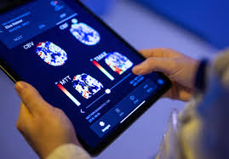
INTRODUCTION :
Introduction:
Technology in our daily lives, AI and machine learning revolutionizes healthcare.
Healthcare is a key beneficiary, AI empowers patient care.

Slide 5
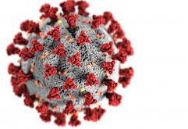
Introduction (cont.)
Global Impact of Covid-19:
Acceleration of the digital revolution
Disruptive technologies shaping various industries
Problem:
Early disease detection crucial for better health.
Current methods often lack accessibility and ease

Slide 6
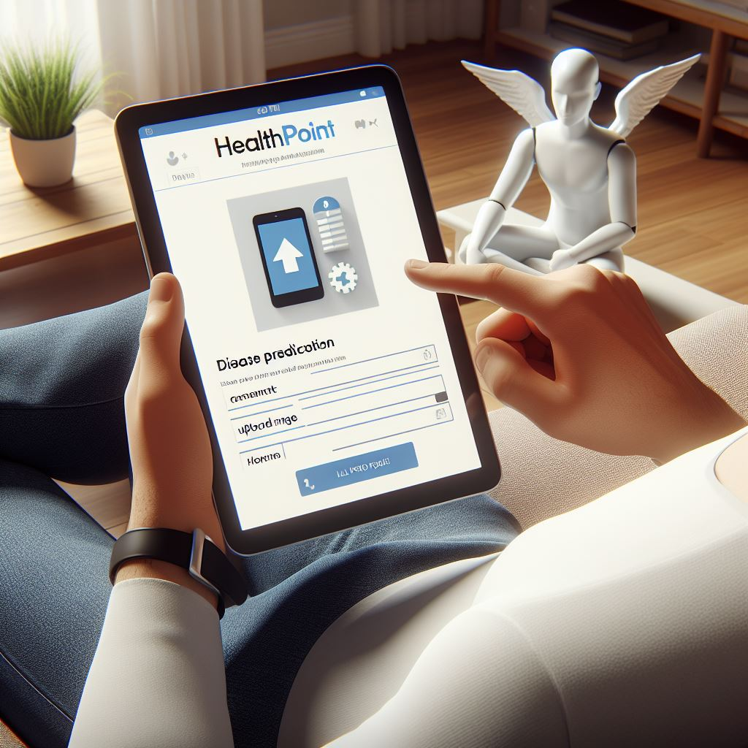
Introduction (cont.)
Solution:
HealthPoint, Predicting diseases through an integrated framework
Detect six diseases with just a few clicks.
Convenient and accessible healthcare solution.
Impact:
Improved health outcomes through early detection.
Empowers individuals to take control of their health.
"For representation only. Actual website may differ "

Slide 7
Literature Survey :
S No. | Title | Strategy | Advantage | Limitation
1. | Challenges of Deep Learning Methods for COVID-19 Detection Using Public Datasets (M. K. Hasan, M. A. Alam, L. Dahal, M. T. E. Elahi, S. Roy, S. R. Wahid, et al. -2020 | Deep Learning for COVID-19 Detection using Public Datasets | Investigates challenges in using public datasets for detection | Varied data quality; generalization issues in diverse datasets
2. | Real-Time Application for Covid-19 Class Detection based CNN Architecture (M. Fradi and M. Machhout) -2021 | Real-Time Application for Covid-19 Class Detection based CNN Architecture | Enables real-time detection of Covid-19 classes | Dependence on real-time data feeds; potential for false positives/negatives
3. | Data-driven modeling and prediction of blood glucose dynamics: Machine learning applications in type 1 diabetes (A. Z. Woldaregay et al.) -2019 | Data-driven Modeling and Prediction of Blood Glucose Dynamics | Machine Learning Applications in Type 1 Diabetes | Enhanced prediction of blood glucose dynamics; personalized treatment

Slide 8
Literature Survey (cont.)
S No. | Title | Strategy | Advantage | Limitation
4. | A Multiple Deep Learner Approach for X-Ray Image-Based Pneumonia Detection (Z. -Y. Yang and Q. Zhao) -2020 | Multiple Deep Learner Approach for X-Ray Image-Based Pneumonia Detection | Enhanced pneumonia detection using multiple deep learners | Increased computational complexity; potential for overfitting in some models
5. | Sensitivity of Chest CT for COVID-19: Comparison to RT-PCR (Yicheng Fang, Huangqi Zhang, Jicheng Xie et al.) -2020 | CT for COVID-19 | Sensitivity Comparison to RT-PCR | Limited specificity; radiation exposure in CT scans
6. | Real-time machine learning for early detection of heart disease using big data approach (A. Ed Daoudy and K. Maalmi) -2019 | Real-time Machine Learning for Early Detection of Heart Disease | Early detection of heart disease using big data approach | Real-time data processing dependencies; potential privacy concerns

Slide 9
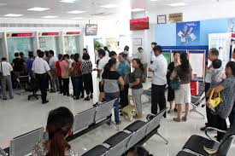
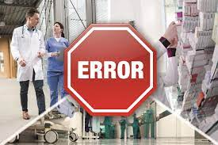
Disadvantages of Existing Systems :
Traditional Systems :
Limited Accessibility
Time-Consuming Processes
Risk of Human Error
Lack of Remote Monitoring
Inefficiencies in Diagnosis

Slide 10
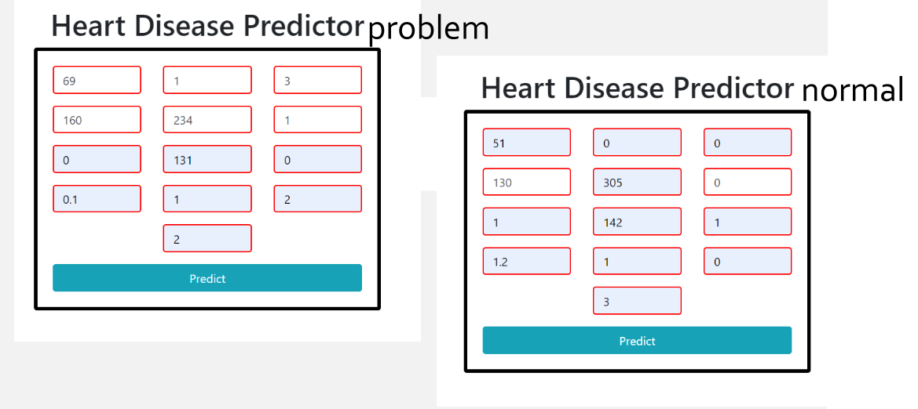


Disadvantages of Existing System (cont.)
Similar Disease Prediction Systems :
Limited scope
No coverage for certain diseases
Ignores specific medical data
Outdated technology
Clunky interface
No data storage

Slide 11
Problem Statement :
To develop HealthPoint, an integrated diagnostic framework for disease prediction. The goal is to enable swift disease prediction, utilizing CNN, Random Forest, and XGBoost. To provide a user-friendly platform, ensuring accessibility, scalability, and secure storage of patient information.

Slide 12
Proposed System :
In the proposed system we aim to provide :
Predictive Disease Detection
User-Friendly Interface
Remote Accessibility
Swift Results and Reduced Waiting Times
Integrated Patient Database
Scalability and Flexibility

Slide 13
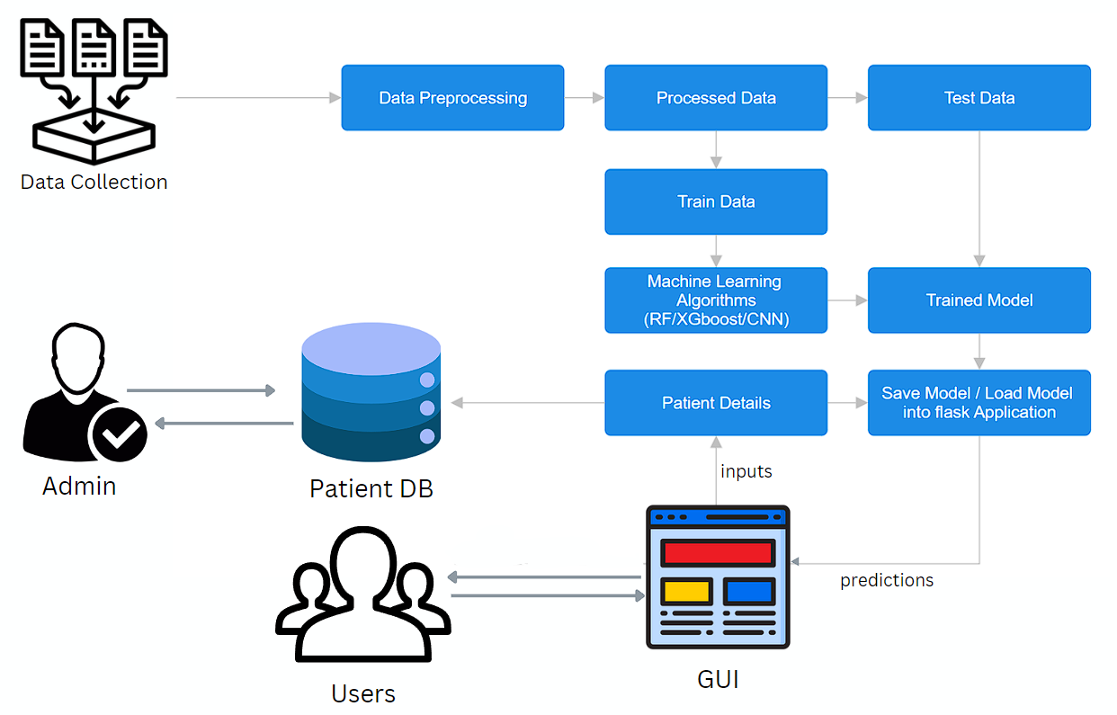
Proposed System (cont.)
Proposed System Architecture

Slide 14
Proposed System (cont.)
Algorithms involved :
Convolutional Neural Networks (CNN)
Covid-19, Pneumonia, Brain Tumour
Specialized for medical imaging tasks
Effective in capturing intricate patterns in medical images
Utilizes convolutional layers for hierarchical feature learning
Outperforms other algorithms in image recognition and pattern detection

Slide 15
Proposed System (cont.)
Random Forest
Diabetes, Breast Cancer
Ensemble approach provides robust predictions for complex tasks
Effective for both classification tasks, such as diabetes and breast cancer prediction
Mitigates overfitting through random subset selection during training
Utilizes multiple decision trees to capture diverse patterns and features in medical data

Slide 16
Proposed System (cont.)
XGBoost
Heart Disease
Belongs to the ensemble learning family
Effective in handling complex patterns in medical data
Sequential tree building corrects errors, enhancing predictive accuracy
Known for speed, efficiency, and effectiveness

Slide 17
Proposed System (cont.)
Development Tools and Technologies:
Model Training - Python (Jupyter Notebook)
Backend – Python (Flask Web Framework)
Frameworks and Libraries – NumPy, Pandas, Scikit-learn, OpenCV, TensorFlow, Flask
Real-Time Storage and Database - Google Firebase
Frontend - HTML, CSS, and JavaScript

Slide 18
Project Plan :
Activity | Plan start (week no.) | Plan duration (no. of weeks) | Actual start (week no.) | Actual Duration (no. of weeks) | Percent complete
Problem Definition | 1 | 2 | 1 | 3 | 100%
Abstract | 3 | 1 | 3 | 1 | 100%
Literature Survey | 3 | 8 | 3 | 9 | 100%
System Analysis | 9 | 5 | 9 | 6 | 100%
REVIEW I | 16 | 1 | 16 | 1
System Design | 17 | 2
Implementation | 19 | 10
Testing | 30 | 2
Documentation | 31 | 1
REVIEW II | 32 | 1

Slide 19
References :
Ed-Daoudy, A., & Maalmi, K. (2019, April). Real-time machine learning for early detection of heart disease using big data approach. In 2019 international conference on wireless technologies, embedded and intelligent systems (WITS) (pp. 1-5). IEEE.
Yang, Z. Y., & Zhao, Q. (2020, December). A multiple deep learner approach for X-ray image-based pneumonia detection. In 2020 international conference on machine learning and cybernetics (ICMLC) (pp. 70-75). IEEE.
Katarya, R., & Jain, S. (2020, December). Comparison of different machine learning models for diabetes detection. In 2020 IEEE International Conference on Advances and Developments in Electrical and Electronics Engineering (ICADEE) (pp. 1-5). IEEE.
Fradi, M., & Machhout, M. (2021, June). Real-Time Application for Covid-19 Class Detection based CNN Architecture. In 2021 IEEE International Conference on Design & Test of Integrated Micro & Nano-Systems (DTS) (pp. 1-6). IEEE.

Slide 20
References (1)..
Gurbină, M., Lascu, M., & Lascu, D. (2019, July). Tumour detection and classification of MRI brain image using different wavelet transforms and support vector machines. In 2019 42nd International Conference on Telecommunications and Signal Processing (TSP) (pp. 505-508). IEEE.
Patil, R. C., & Bhalchandra, A. S. (2012). Brain tumour extraction from MRI images using MATLAB. International Journal of Electronics, Communication and Soft Computing Science & Engineering (IJECSCSE), 2(1), 1.
Pena-Reyes, C. A., & Sipper, M. (1999). A fuzzy-genetic approach to breast cancer diagnosis. Artificial intelligence in medicine, 17(2), 131-155.
McMorran, J. (2009). Crowther., DC,“Fine needle aspiration cytology (breast)”. General Practice Notebook–a UK medical reference on the world wide web.
Zhu, N., Zhang, D., Wang, W., Li, X., Yang, B., Song, J., ... & Tan, W. (2020). A novel coronavirus from patients with pneumonia in China, 2019. New England journal of medicine, 382(8), 727-733.

Slide 21
References (2)..
Abbas al-sammarraie, L. H., & Ibrahim, A. A. (2020, October). Predicting breast cancer in fine needle aspiration images using machine learning. In 2020 4th International Symposium on Multidisciplinary Studies and Innovative Technologies (ISMSIT) (pp. 1-4). IEEE.
Fang, Y., Zhang, H., Xie, J., Lin, M., Ying, L., Pang, P., & Ji, W. (2020). Sensitivity of chest CT for COVID-19: comparison to RT-PCR. Radiology, 296(2), E115-E117.
Al-Saffar, A. A. M., Tao, H., & Talab, M. A. (2017, October). Review of deep convolution neural network in image classification. In 2017 International conference on radar, antenna, microwave, electronics, and telecommunications (ICRAMET) (pp. 26-31). IEEE.
Hasan, M. K., Alam, M. A., Dahal, L., Roy, S., Wahid, S. R., Elahi, M. T. E., ... & Khanal, B. (2022). Challenges of deep learning methods for COVID-19 detection using public datasets. Informatics in Medicine Unlocked, 30, 100945.

Slide 22
THANK YOU

